Slide 1

HR ANALYTICS Dashboard
Final presentation

Slide 2
Group-5
Mr. Sumit Rajaram Pujare
Mr Kondakari Lakshmi Ganesh
Mrs. Anjana C
Ms. Digdarshini Das
Mr. Aniket Vasudev Gambhire
Ahir Vishwa Bhadreshbhai

Slide 3

Human resource department and their challenges:
The HR department is responsible for monitoring and managing various aspects of employee data to ensure the organization maintains a healthy workforce. However, there is a lack of clear performance indicators to track and analyze key HR metrics. Therefore, there is a need to design and implement a set of KPIs to address the specific HR problems.

Slide 4

Key performance indicators
Employee
Count
50000
Attrition
Count
25,105
Key Performance Indicators (KPIs) in an HR Analytics dashboard are crucial for assessing and improving various aspects of human resources management. They provide measurable insights into employee performance, organizational efficiency, and overall workforce health. KPIs help identify trends, measure the success of HR initiatives, and enable data-driven decision-making.
Attrition
Rate
50.21%
Active Employees
24,895
Average
Age
39

Slide 5
Key performance indicators
Employee
Count
50000
Attrition
Count
25,105
The HR department lacks visibility into the total number of employees, making it challenging to access workforce size and plan for future growth or downsizing effectively.
Attrition
Rate
50.21%
Active Employees
24,895
Average
Age
39

Slide 6
Key performance indicators
Employee
Count
50000
Attrition
Count
25,105
The organization lacks a standardized method to track employee attrition, resulting in incomplete and unreliable data on the number of employees who have left the organization.
Attrition
Rate
50.21%
Active Employees
24,895
Average
Age
39

Slide 7
Key performance indicators
Employee
Count
50000
Attrition
Count
25,105
Without a clear measure of attrition rate, the organization cannot access the overall turnover level or compare it with industry benchmark, hindering the ability to gauge employee satisfaction and engagement.
Attrition
Rate
50.21%
Active Employees
24,895
Average
Age
39

Slide 8
Key performance indicators
Employee
Count
50000
Attrition
Count
25,105
The organization lacks a mechanism to differentiate between active and inactive employees, leading to difficulties in accurately assessing the current workforce’s productivity and capacity.
Attrition
Rate
50.21%
Active Employees
24,895
Average
Age
39

Slide 9
Key performance indicators
Employee
Count
50000
Attrition
Count
25,105
The HR department lacks visibility into the average age of employees, making it difficult to evaluate workforce demographics, succession planning, and the organization’s ability to attract and retain young talent.
Attrition
Rate
50.21%
Active Employees
24,895
Average
Age
39

Slide 10
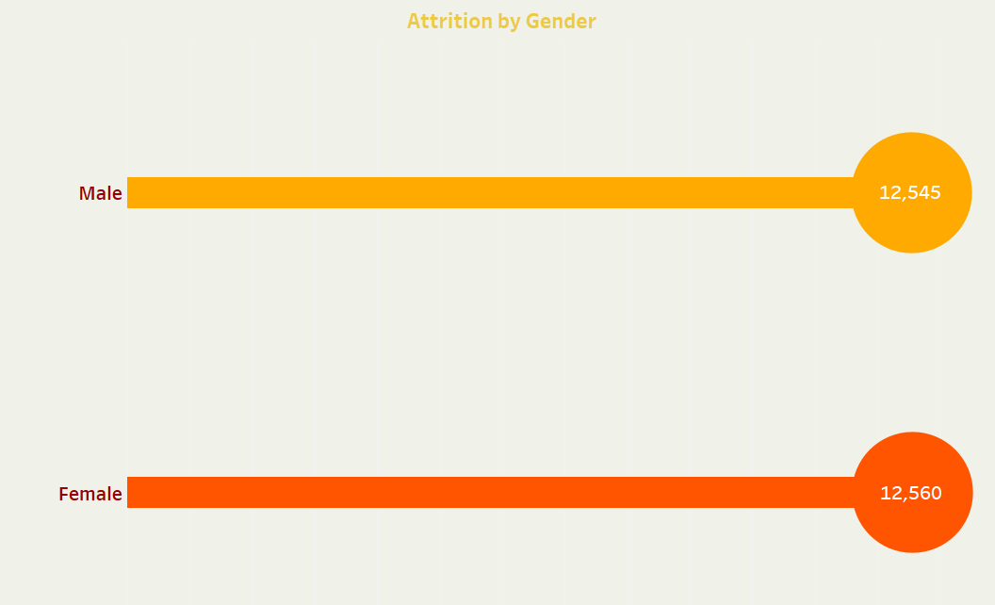
Attrition by gender:
The HR department faces challenges in understanding the attrition patterns based on gender, making it difficult to identify any gender-related disparities and implement targeted retention strategies.

Slide 11
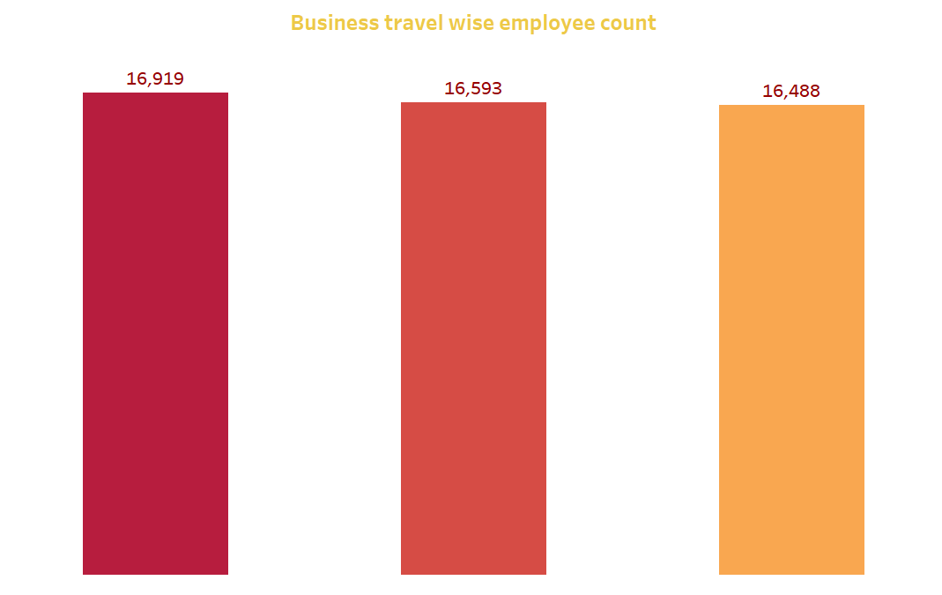
Business travel wise employee count:
Understand the total employee count and the specific number actively involved in business travel and key metrics and a departmental breakdown, provides strategic insights for informed decision-making. Optimize travel policies, identify trends, and enhance support where needed for a more effective and satisfied. team.

Slide 12
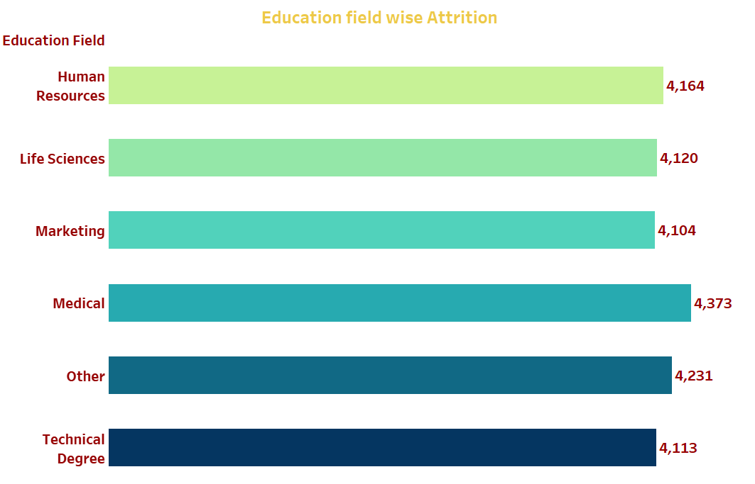
Education field wise attrition:
The HR department requires visual representation to analyze attrition rates based on education fields. This helps identify specific educational backgrounds that may be associated with higher attrition, enabling the organization to tailor retention strategies accordingly.

Slide 13
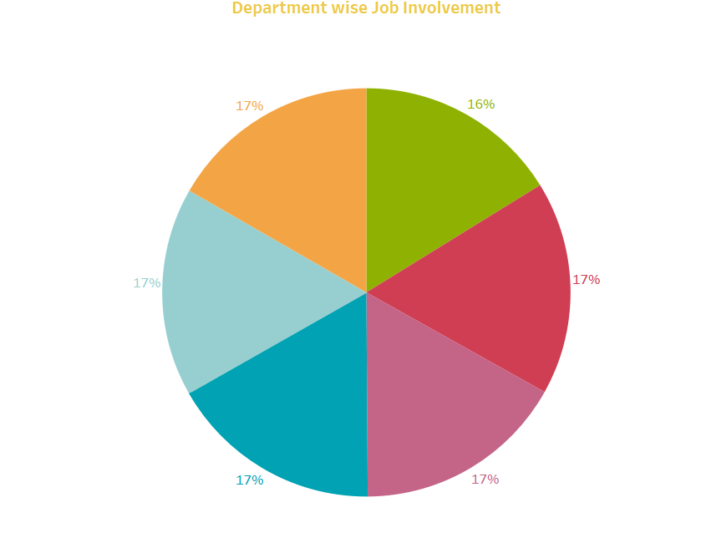
Department wise job involvement(percent):
Visual representation of job involvement across different departments pie chart showcasing the distribution of employees in each department. Use color-coded segments for easy interpretation.

Slide 14
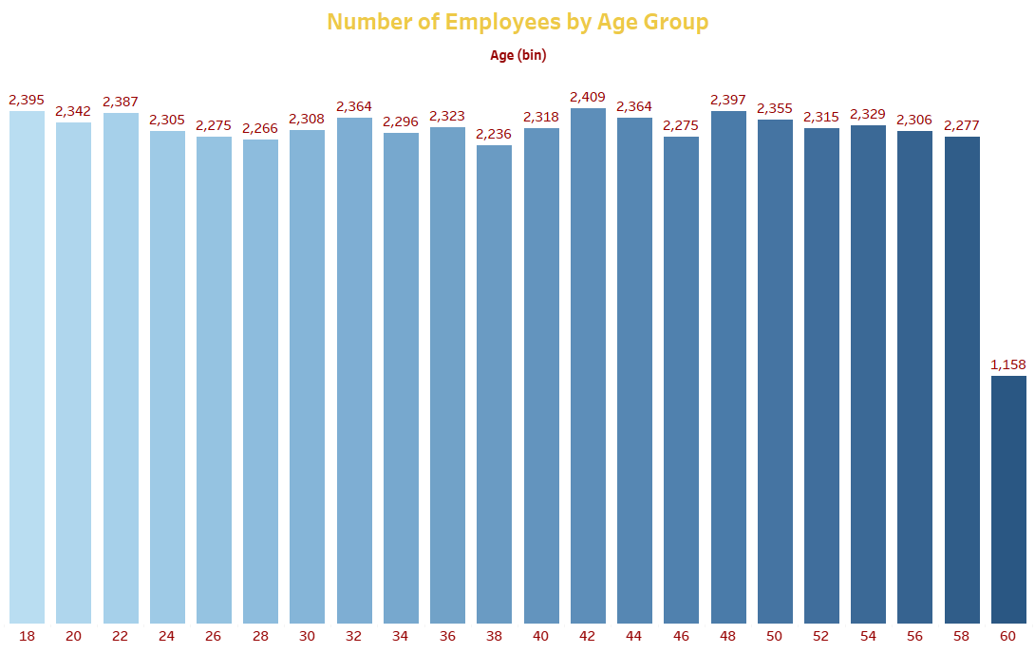
Age group wise number of employees:
The HR department lacks visualization that displays attrition rates based on gender and different age groups. This makes it challenging to identify any age and gender related attrition trends, preventing the organization from implementing targeted retention strategies for specific employee segments.

Slide 15
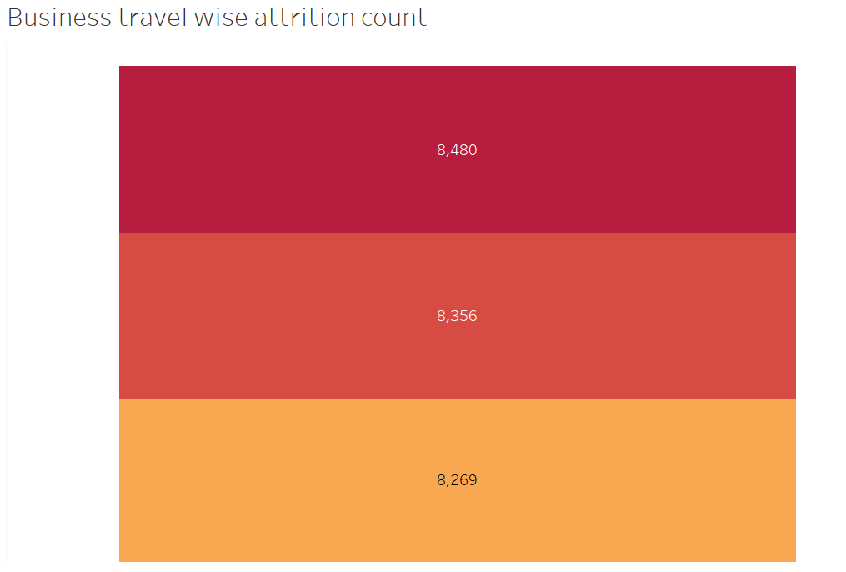
Business travel wise attrition count:
Compare business travel metrics with attrition data. bar chart to identify any correlation between business travel and attrition count.

Slide 16
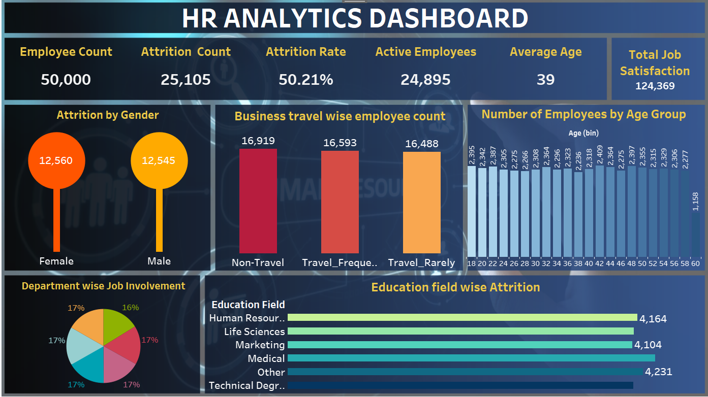

Slide 17
Suggestions for management:
Elevate decision-making with Management Insights. Quickly assess key HR metrics, departmental performance, and employee engagement. Uncover attrition trends, skills gaps, and potential leaders for effective succession planning. Recommendations focus on optimizing recruitment, fostering diversity, and enhancing employee well-being. Actionable insights empower management to make informed decisions and drive organizational success.

Slide 18

Thank You
excelr

